Slide 1
ETRSS-1
DTS Module Design Proposal
DFH SATELLITE CO.,LTD
February.2019

Slide 2
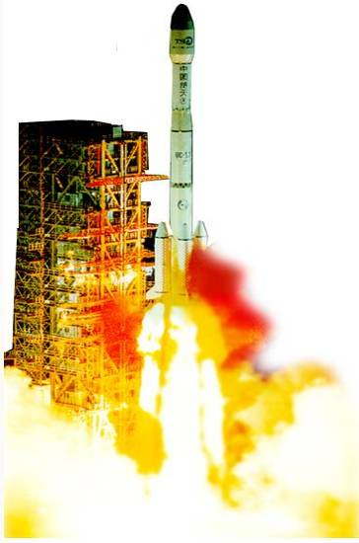






OUTLINES
Introduction to DTS
Data Handling
Data Transmission
THIS DOCUMENT CONTAINS PROPRIETARY INFORMATION OF CHINA ACADEMY OF SPACE TECHNOLOGY, AND MAY NOT BE REPRODUCED, COPIED, DISCLOSED, UTILIZED, PLACED OR TRANSMITTED ON INTERNET, IN WHOLE OR IN PART, WITHOUT PRIOR WRITTEN AUTHORIZATION.
PAGE <number>
Notes:
Since this is a travel, if we have a map in hand, we will know where we are and where to go.
So the first part, we will have a brief introduction to DTS.

Slide 3
Introduction to DTS - Function
  DTS shall provide the following functions:
    To record the MSC data by storage device.
    To compress the remote sensing data from MSC.
    To replay data in storage device to ground station.
    To transmit data to ground station.
THIS DOCUMENT CONTAINS PROPRIETARY INFORMATION OF CHINA ACADEMY OF SPACE TECHNOLOGY, AND MAY NOT BE REPRODUCED, COPIED, DISCLOSED, UTILIZED, PLACED OR TRANSMITTED ON INTERNET, IN WHOLE OR IN PART, WITHOUT PRIOR WRITTEN AUTHORIZATION.
PAGE <number>
Notes:
The main work of DTS is on data, such as
To record the MSC data by storage device.
To compress the remote sensing data from MSC.
To replay data in storage device to ground station.
To transmit data to ground station.
In order to complete the function, the DTS

Slide 4
Introduction to DTS - Function
  Baseband Data Processing
    Compressing
    AOS Data Framing
    Data Frame Recording & Playback
  RF Signal Transmitting
  Modulation
  Power Amplification
  Radiation
THIS DOCUMENT CONTAINS PROPRIETARY INFORMATION OF CHINA ACADEMY OF SPACE TECHNOLOGY, AND MAY NOT BE REPRODUCED, COPIED, DISCLOSED, UTILIZED, PLACED OR TRANSMITTED ON INTERNET, IN WHOLE OR IN PART, WITHOUT PRIOR WRITTEN AUTHORIZATION.
PAGE <number>

Slide 5
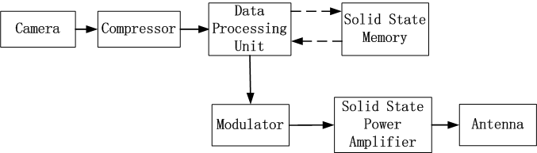
Introduction to DTS - Compose
THIS DOCUMENT CONTAINS PROPRIETARY INFORMATION OF CHINA ACADEMY OF SPACE TECHNOLOGY, AND MAY NOT BE REPRODUCED, COPIED, DISCLOSED, UTILIZED, PLACED OR TRANSMITTED ON INTERNET, IN WHOLE OR IN PART, WITHOUT PRIOR WRITTEN AUTHORIZATION.
PAGE <number>
Notes:
The data flow of the whole process is as above.
1) The compression ratio shall be designed according to the mission analysis and data transmission equipment specification.
2) Image data from MSC shall be handled by camera’s circuit first, and then transmitted to DTS all-in-one equipment through LVDS data bus.
3) The Image data from MSC shall be compressed by compressor, then formatted under AOS protocol, then encoded in LDPC and scrambled by DTS all-in-one equipment according to CCSDS standards. At last the signals are transmitted by Phased-array antenna.
4) Formatted image shall be processed according to the different operation modes. The data shall be stored in the solid state memory in record mode; be transmitted to GS directly by X band modulator in real time mode; be retrieved by DPU from solid state memory and transmitted to GS by modulator in replay mode.

Slide 6
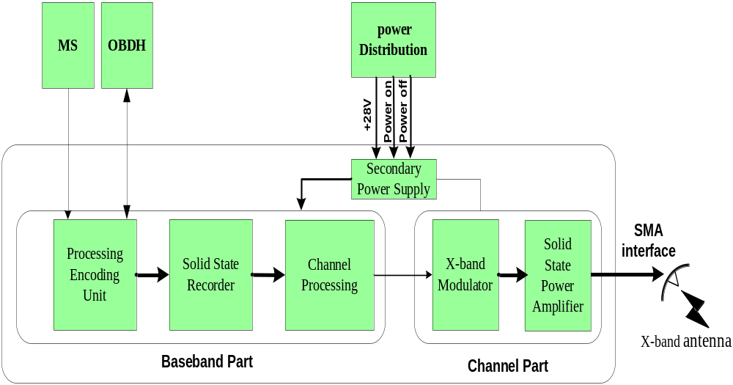
Introduction to DTS - Compose
MSC
Compressor SSM DPU Modulator SSPA Antenna
THIS DOCUMENT CONTAINS PROPRIETARY INFORMATION OF CHINA ACADEMY OF SPACE TECHNOLOGY, AND MAY NOT BE REPRODUCED, COPIED, DISCLOSED, UTILIZED, PLACED OR TRANSMITTED ON INTERNET, IN WHOLE OR IN PART, WITHOUT PRIOR WRITTEN AUTHORIZATION.
PAGE <number>

Slide 7
Introduction to DTS - Performance
  DTS All-in-one machine
No. | Items | Demand
01 | Frequency | 8160MHz
02 | Channel Rate | 100Mbps
03 | Code type | LDPC
04 | Modulation | QPSK
05 | Memory Space | ≥256Gbit
THIS DOCUMENT CONTAINS PROPRIETARY INFORMATION OF CHINA ACADEMY OF SPACE TECHNOLOGY, AND MAY NOT BE REPRODUCED, COPIED, DISCLOSED, UTILIZED, PLACED OR TRANSMITTED ON INTERNET, IN WHOLE OR IN PART, WITHOUT PRIOR WRITTEN AUTHORIZATION.
PAGE <number>

Slide 8
Introduction to DTS - Performance
  Antenna
No. | Items | Demand
01 | Frequency | 8100-8300MHz
02 | Band Width | ≥200MHz
03 | Polar Type | Circular Right-hand
04 | SWR | ≤1.5
05 | Interface | SMA
THIS DOCUMENT CONTAINS PROPRIETARY INFORMATION OF CHINA ACADEMY OF SPACE TECHNOLOGY, AND MAY NOT BE REPRODUCED, COPIED, DISCLOSED, UTILIZED, PLACED OR TRANSMITTED ON INTERNET, IN WHOLE OR IN PART, WITHOUT PRIOR WRITTEN AUTHORIZATION.
PAGE <number>

Slide 9





OUTLINES
Introduction to DTS
Data Handling
Data Transmission
THIS DOCUMENT CONTAINS PROPRIETARY INFORMATION OF CHINA ACADEMY OF SPACE TECHNOLOGY, AND MAY NOT BE REPRODUCED, COPIED, DISCLOSED, UTILIZED, PLACED OR TRANSMITTED ON INTERNET, IN WHOLE OR IN PART, WITHOUT PRIOR WRITTEN AUTHORIZATION.
PAGE <number>

Slide 10
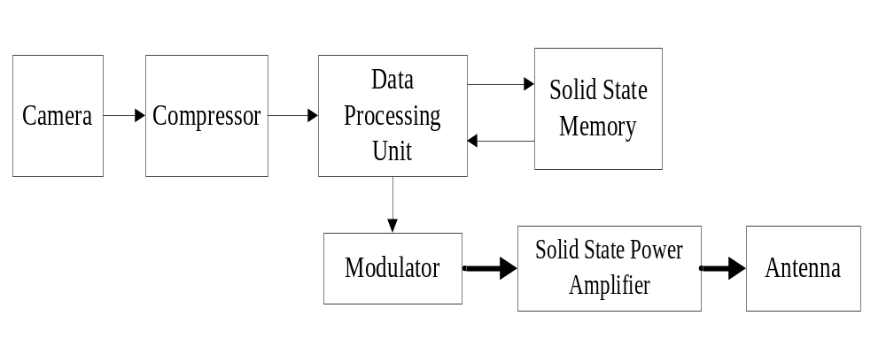
Data Handling - Introduction
Baseband Data Processing
  Compressing
  AOS Data Framing
  Data Frame Recording & Playback
X-band RF Signal Transmitting
  Modulation
  Power Amplification
  Radiation
THIS DOCUMENT CONTAINS PROPRIETARY INFORMATION OF CHINA ACADEMY OF SPACE TECHNOLOGY, AND MAY NOT BE REPRODUCED, COPIED, DISCLOSED, UTILIZED, PLACED OR TRANSMITTED ON INTERNET, IN WHOLE OR IN PART, WITHOUT PRIOR WRITTEN AUTHORIZATION.
PAGE <number>

Slide 11
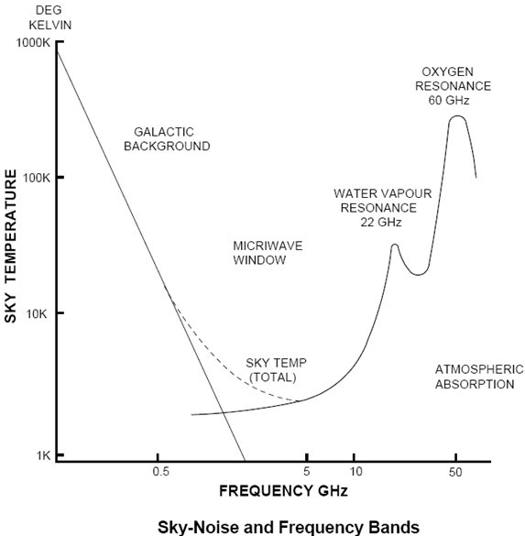
Data Handling – Mission Analysis
Frequency Band
  As the signal levels from the satellite are expected to be very low, any natural phenomena to facilitate the reception of the incoming signal must be exploited. Note that between the frequencies of 2 GHz to 10 GHz the level of the sky noise diminishes, and this band is known as the "microwave window.”
THIS DOCUMENT CONTAINS PROPRIETARY INFORMATION OF CHINA ACADEMY OF SPACE TECHNOLOGY, AND MAY NOT BE REPRODUCED, COPIED, DISCLOSED, UTILIZED, PLACED OR TRANSMITTED ON INTERNET, IN WHOLE OR IN PART, WITHOUT PRIOR WRITTEN AUTHORIZATION.
PAGE <number>

Slide 12
Data Handling – Mission Analysis
Frequency Band
  Low Frequency
    Hard to be transmitted：For successful radiation, the size of antenna should be no less than 1/10 of the wavelength of signal transmitted.
      F=30MHz → λ=10Km→ D＞1Km
THIS DOCUMENT CONTAINS PROPRIETARY INFORMATION OF CHINA ACADEMY OF SPACE TECHNOLOGY, AND MAY NOT BE REPRODUCED, COPIED, DISCLOSED, UTILIZED, PLACED OR TRANSMITTED ON INTERNET, IN WHOLE OR IN PART, WITHOUT PRIOR WRITTEN AUTHORIZATION.
PAGE <number>

Slide 13
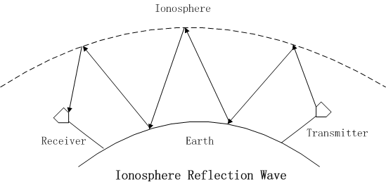
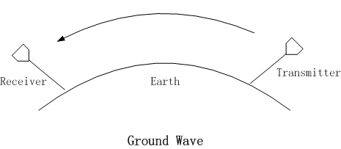
Data Handling – Mission Analysis
Frequency Band
  Low Frequency
    Cannot penetrate the ionosphere：
      <2MHz — Travel along the surface of the Earth (Ground Wave)
      2M-30MHz — bounce between the ionosphere and the surface (Ionosphere Reflection Wave)
THIS DOCUMENT CONTAINS PROPRIETARY INFORMATION OF CHINA ACADEMY OF SPACE TECHNOLOGY, AND MAY NOT BE REPRODUCED, COPIED, DISCLOSED, UTILIZED, PLACED OR TRANSMITTED ON INTERNET, IN WHOLE OR IN PART, WITHOUT PRIOR WRITTEN AUTHORIZATION.
PAGE <number>

Slide 14
Data Handling – Mission Analysis
Frequency Band
  High Frequency
    High frequency, high attenuation.
    Rain attenuation is significant for frequencies higher than 10GHz.
  We usually use X-band (8G-12GHz) for Data Transmission of Remote Sensing Satellite.
  ITU Regulation: for X-band Satellite Earth Exploration, the available frequency band is 8025-8400MHz.
THIS DOCUMENT CONTAINS PROPRIETARY INFORMATION OF CHINA ACADEMY OF SPACE TECHNOLOGY, AND MAY NOT BE REPRODUCED, COPIED, DISCLOSED, UTILIZED, PLACED OR TRANSMITTED ON INTERNET, IN WHOLE OR IN PART, WITHOUT PRIOR WRITTEN AUTHORIZATION.
PAGE <number>

Slide 15
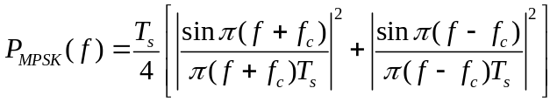
Data Handling – Mission Analysis
Modulation
  For low-speed data transmission applications (<600Mbps), MPSK (Multi-level Phase Shift Key) modulation is the most widely used type.
  To make better use of valuable frequency resource, we need to increase Bandwidth Efficiency by increasing modulation level.
P_{MPSK}(f) | Power Spectral Spectrum of MPSK Signal
T_{s} | Time Period for 1 Transmitted Symbol
f_{c} | Carrier Frequency
M | Level of Modulation For BPSK, M=2 For QPSK, M=4
THIS DOCUMENT CONTAINS PROPRIETARY INFORMATION OF CHINA ACADEMY OF SPACE TECHNOLOGY, AND MAY NOT BE REPRODUCED, COPIED, DISCLOSED, UTILIZED, PLACED OR TRANSMITTED ON INTERNET, IN WHOLE OR IN PART, WITHOUT PRIOR WRITTEN AUTHORIZATION.
PAGE <number>

Slide 16
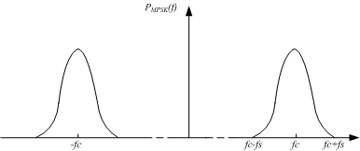
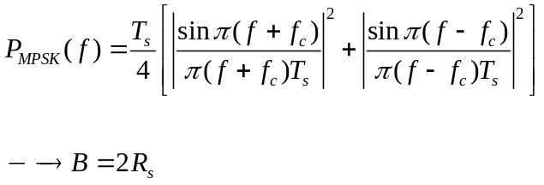
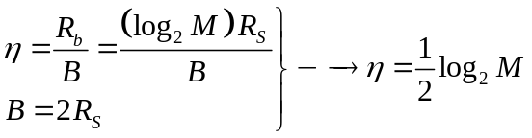
Data Handling – Mission Analysis
Modulation
R_{b} | Bit Rate
R_{S} | Symbol Rate
B | Bandwidth
M | Level of Modulation For BPSK, M=2 For QPSK, M=4
THIS DOCUMENT CONTAINS PROPRIETARY INFORMATION OF CHINA ACADEMY OF SPACE TECHNOLOGY, AND MAY NOT BE REPRODUCED, COPIED, DISCLOSED, UTILIZED, PLACED OR TRANSMITTED ON INTERNET, IN WHOLE OR IN PART, WITHOUT PRIOR WRITTEN AUTHORIZATION.
PAGE <number>

Slide 17
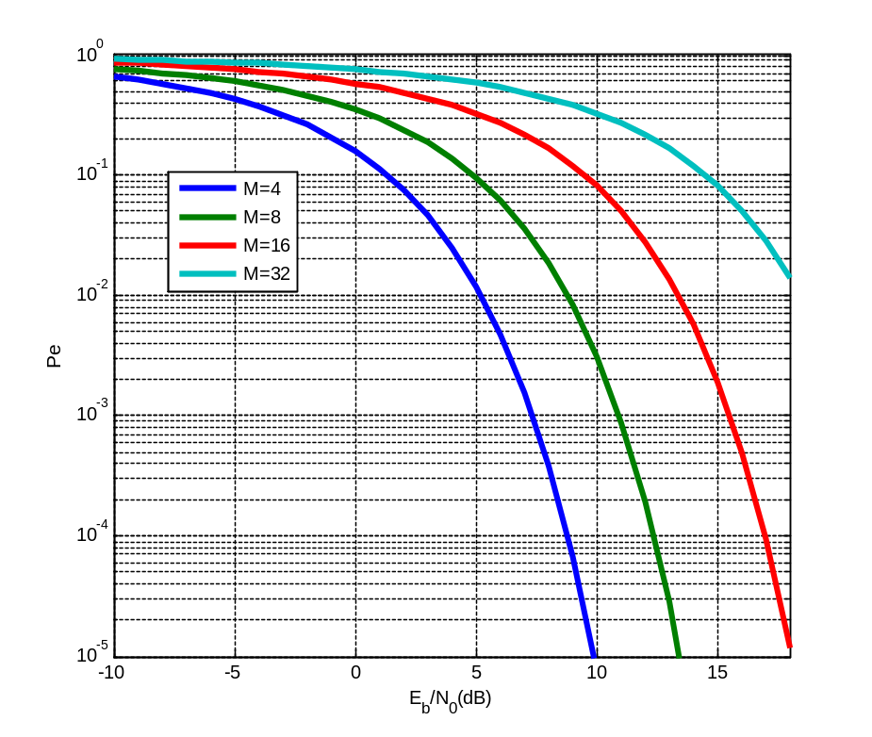
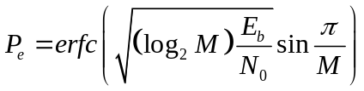
Data Handling – Mission Analysis
Modulation
  For higher bandwidth efficiency, we need to increase signal power to achieve same P_{e} level.
  For MPSK system,
P_{e} | Bit Error Rate
E_{b} | Bit Energy
N₀ | Single Side Band Noise Power Spectral Density
M | Level of Modulation For BPSK, M=2 For QPSK, M=4
THIS DOCUMENT CONTAINS PROPRIETARY INFORMATION OF CHINA ACADEMY OF SPACE TECHNOLOGY, AND MAY NOT BE REPRODUCED, COPIED, DISCLOSED, UTILIZED, PLACED OR TRANSMITTED ON INTERNET, IN WHOLE OR IN PART, WITHOUT PRIOR WRITTEN AUTHORIZATION.
PAGE <number>

Slide 18
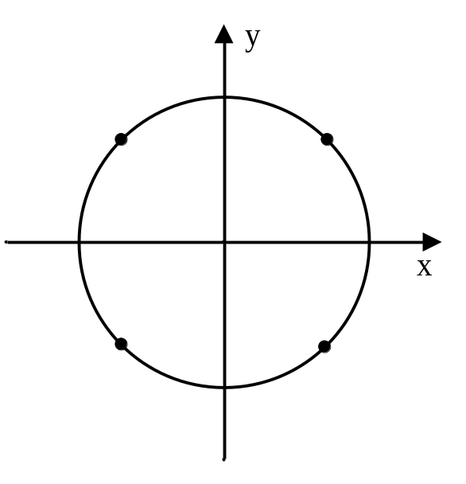
Data Handling – Mission Analysis
Modulation
QPSK modulation is a good choice to balance bandwidth efficiency and power efficiency.
QPSK Constellation
THIS DOCUMENT CONTAINS PROPRIETARY INFORMATION OF CHINA ACADEMY OF SPACE TECHNOLOGY, AND MAY NOT BE REPRODUCED, COPIED, DISCLOSED, UTILIZED, PLACED OR TRANSMITTED ON INTERNET, IN WHOLE OR IN PART, WITHOUT PRIOR WRITTEN AUTHORIZATION.
PAGE <number>

Slide 19
Data Handling – Mission Analysis
Memory space
The channel data rate is 100Mbps，SSM’s writing rate is 140Mbps and raw data rate from camera and auxiliary is 133.6Mbps. The rate after compressing is 133.6Mbps /1.25(Lossless compression)=106.88Mbps。
If the SSM is 256Gbit,we can store 256000Mb/（106.88+1.4）Mbps= 2364 second。
The space can meet the task requirements.
THIS DOCUMENT CONTAINS PROPRIETARY INFORMATION OF CHINA ACADEMY OF SPACE TECHNOLOGY, AND MAY NOT BE REPRODUCED, COPIED, DISCLOSED, UTILIZED, PLACED OR TRANSMITTED ON INTERNET, IN WHOLE OR IN PART, WITHOUT PRIOR WRITTEN AUTHORIZATION.
PAGE <number>

Slide 20
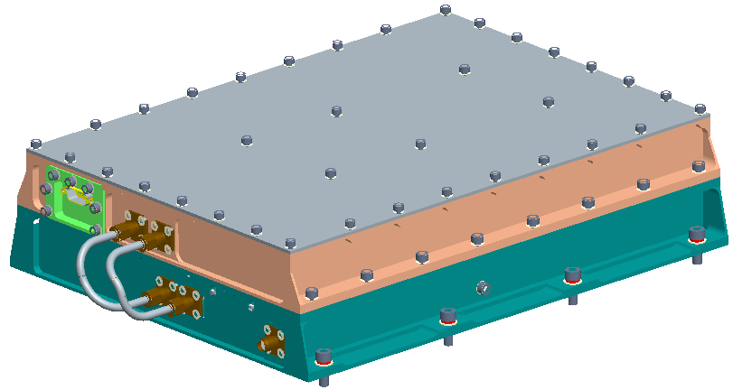
Data Handling - Introduction
  DTS All-in-one machine
THIS DOCUMENT CONTAINS PROPRIETARY INFORMATION OF CHINA ACADEMY OF SPACE TECHNOLOGY, AND MAY NOT BE REPRODUCED, COPIED, DISCLOSED, UTILIZED, PLACED OR TRANSMITTED ON INTERNET, IN WHOLE OR IN PART, WITHOUT PRIOR WRITTEN AUTHORIZATION.
PAGE <number>

Slide 21
Data Handling - Introduction
  Compressors achieves the functions of compressing the camera’s data.
  The main function of SSM is to record the data captured from compressor and play-back the stored data to DPU to transmit down to ground station.
  DPU achieves the functions of AOS encoding, scrambling and channel encoding.
THIS DOCUMENT CONTAINS PROPRIETARY INFORMATION OF CHINA ACADEMY OF SPACE TECHNOLOGY, AND MAY NOT BE REPRODUCED, COPIED, DISCLOSED, UTILIZED, PLACED OR TRANSMITTED ON INTERNET, IN WHOLE OR IN PART, WITHOUT PRIOR WRITTEN AUTHORIZATION.
PAGE <number>

Slide 22
Data Handling - Introduction
  Modulator modulates baseband data on the carrier wave with QPSK modulation.
  SSPA amplifying the modulated signal to enough power, and then sending to the earth station through the antenna.
  Antenna transmits electro-magnetic wave.
THIS DOCUMENT CONTAINS PROPRIETARY INFORMATION OF CHINA ACADEMY OF SPACE TECHNOLOGY, AND MAY NOT BE REPRODUCED, COPIED, DISCLOSED, UTILIZED, PLACED OR TRANSMITTED ON INTERNET, IN WHOLE OR IN PART, WITHOUT PRIOR WRITTEN AUTHORIZATION.
PAGE <number>

Slide 23
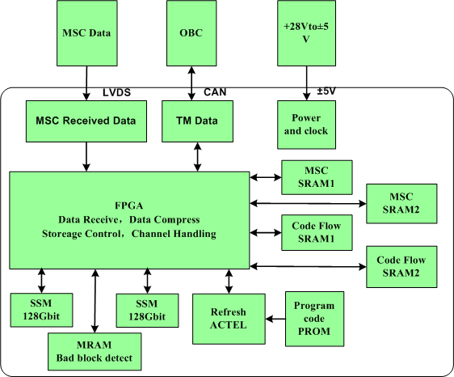
Data Handling - Introduction
THIS DOCUMENT CONTAINS PROPRIETARY INFORMATION OF CHINA ACADEMY OF SPACE TECHNOLOGY, AND MAY NOT BE REPRODUCED, COPIED, DISCLOSED, UTILIZED, PLACED OR TRANSMITTED ON INTERNET, IN WHOLE OR IN PART, WITHOUT PRIOR WRITTEN AUTHORIZATION.
PAGE <number>

Slide 24
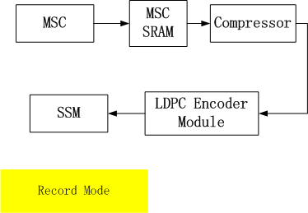
Data Handling - Introduction
  Data Operation Modes
    Record Mode: Get data from MSC, format and record it in storage device;
THIS DOCUMENT CONTAINS PROPRIETARY INFORMATION OF CHINA ACADEMY OF SPACE TECHNOLOGY, AND MAY NOT BE REPRODUCED, COPIED, DISCLOSED, UTILIZED, PLACED OR TRANSMITTED ON INTERNET, IN WHOLE OR IN PART, WITHOUT PRIOR WRITTEN AUTHORIZATION.
PAGE <number>

Slide 25
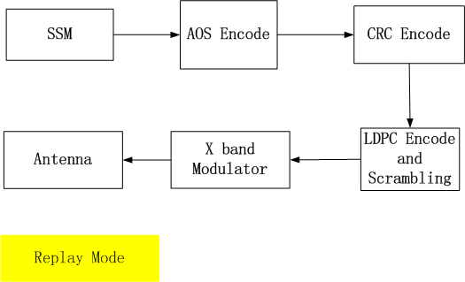
Data Handling - Introduction
  Data Operation Modes
    Replay Mode: Transmit data in the storage device to the ground station;
THIS DOCUMENT CONTAINS PROPRIETARY INFORMATION OF CHINA ACADEMY OF SPACE TECHNOLOGY, AND MAY NOT BE REPRODUCED, COPIED, DISCLOSED, UTILIZED, PLACED OR TRANSMITTED ON INTERNET, IN WHOLE OR IN PART, WITHOUT PRIOR WRITTEN AUTHORIZATION.
PAGE <number>

Slide 26
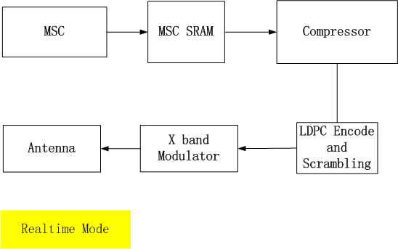
Data Handling - Introduction
  Data Operation Modes
    Real time Mode: Transmit MSC data to the ground station in real time;
THIS DOCUMENT CONTAINS PROPRIETARY INFORMATION OF CHINA ACADEMY OF SPACE TECHNOLOGY, AND MAY NOT BE REPRODUCED, COPIED, DISCLOSED, UTILIZED, PLACED OR TRANSMITTED ON INTERNET, IN WHOLE OR IN PART, WITHOUT PRIOR WRITTEN AUTHORIZATION.
PAGE <number>

Slide 27
Data Handling - Introduction
  Before transmission, the MSC data should be compressed firstly.
    The total incoming raw data from MSC is about 135Mbps;
    In order to fit into the available data rates of the DTS,
      whether to be transmitted down to ground station by 100 Mbps through antenna;
      or to be recorded up to 140 Mbps by SSM(Solid State Memory).
THIS DOCUMENT CONTAINS PROPRIETARY INFORMATION OF CHINA ACADEMY OF SPACE TECHNOLOGY, AND MAY NOT BE REPRODUCED, COPIED, DISCLOSED, UTILIZED, PLACED OR TRANSMITTED ON INTERNET, IN WHOLE OR IN PART, WITHOUT PRIOR WRITTEN AUTHORIZATION.
PAGE <number>

Slide 28
Data Handling – Compress Ratio
  Compress Ratio
    The bigger the ratio is, the more the images can be transmitted to ground in the same time. The lower the ratio is, the better the quality of restored images is.
    Make sure the framed-compressed data rate doesn’t exceed R_{max}, where:
      R_{max} is channel data rate in real-time transmission mode, which is 100Mbps;
      R_{max} is SSM’s writing rate in record-replay mode, which is 135Mbps.
No. | Operation Mode | Compression
01 | Real Time Mode | 2:1
02 | Record Mode | Lossless compression (Almost 1.25:1)
THIS DOCUMENT CONTAINS PROPRIETARY INFORMATION OF CHINA ACADEMY OF SPACE TECHNOLOGY, AND MAY NOT BE REPRODUCED, COPIED, DISCLOSED, UTILIZED, PLACED OR TRANSMITTED ON INTERNET, IN WHOLE OR IN PART, WITHOUT PRIOR WRITTEN AUTHORIZATION.
PAGE <number>

Slide 29
Data Handling – DPU
  Data Processing Unit(DPU)
    Pack to AOS standard format according to CCSDS recommendation;
    Do LDPC encode;
    Scramble encoded data;
    Switch data stream according to operation mode.
THIS DOCUMENT CONTAINS PROPRIETARY INFORMATION OF CHINA ACADEMY OF SPACE TECHNOLOGY, AND MAY NOT BE REPRODUCED, COPIED, DISCLOSED, UTILIZED, PLACED OR TRANSMITTED ON INTERNET, IN WHOLE OR IN PART, WITHOUT PRIOR WRITTEN AUTHORIZATION.
PAGE <number>

Slide 30
Data Handling – SSM
  Solid State Memory(SSM)
    Record data from DPU to files;
      SSM manages data by files;
      Each time SSM receives a Record By File Number datablock, SSM will start recording and generate a file whose file number is assigned by the datablock;
      If no stop command is received before SSM powered off, no file will be generated and may also cause disorder to SSM’s file management system;
      If no data is received before stop recording , no file will be generated either;
      SSM will discard DPU’s filling frames before recording.
THIS DOCUMENT CONTAINS PROPRIETARY INFORMATION OF CHINA ACADEMY OF SPACE TECHNOLOGY, AND MAY NOT BE REPRODUCED, COPIED, DISCLOSED, UTILIZED, PLACED OR TRANSMITTED ON INTERNET, IN WHOLE OR IN PART, WITHOUT PRIOR WRITTEN AUTHORIZATION.
PAGE <number>

Slide 31
Data Handling – SSM
  Solid State Memory(SSM)
    Replay data to DPU
      By file name, e.g. 0#/1#/……;
      By record time, e.g. 1000s—1050s;
      By sequence, replay from the beginning of SSM; will replay to the end of SSM and roll back to the beginning if no stop command is received;
    Record & Replay
      First record a new file then replay the same file shortly afterwards;
THIS DOCUMENT CONTAINS PROPRIETARY INFORMATION OF CHINA ACADEMY OF SPACE TECHNOLOGY, AND MAY NOT BE REPRODUCED, COPIED, DISCLOSED, UTILIZED, PLACED OR TRANSMITTED ON INTERNET, IN WHOLE OR IN PART, WITHOUT PRIOR WRITTEN AUTHORIZATION.
PAGE <number>

Slide 32
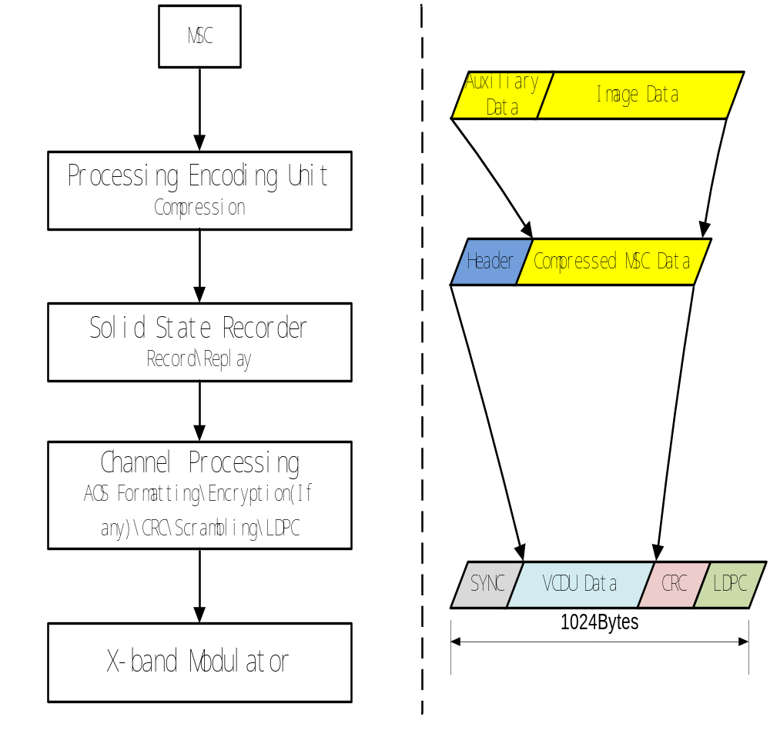
Data Handling– Data Flow
THIS DOCUMENT CONTAINS PROPRIETARY INFORMATION OF CHINA ACADEMY OF SPACE TECHNOLOGY, AND MAY NOT BE REPRODUCED, COPIED, DISCLOSED, UTILIZED, PLACED OR TRANSMITTED ON INTERNET, IN WHOLE OR IN PART, WITHOUT PRIOR WRITTEN AUTHORIZATION.
PAGE <number>

Slide 33
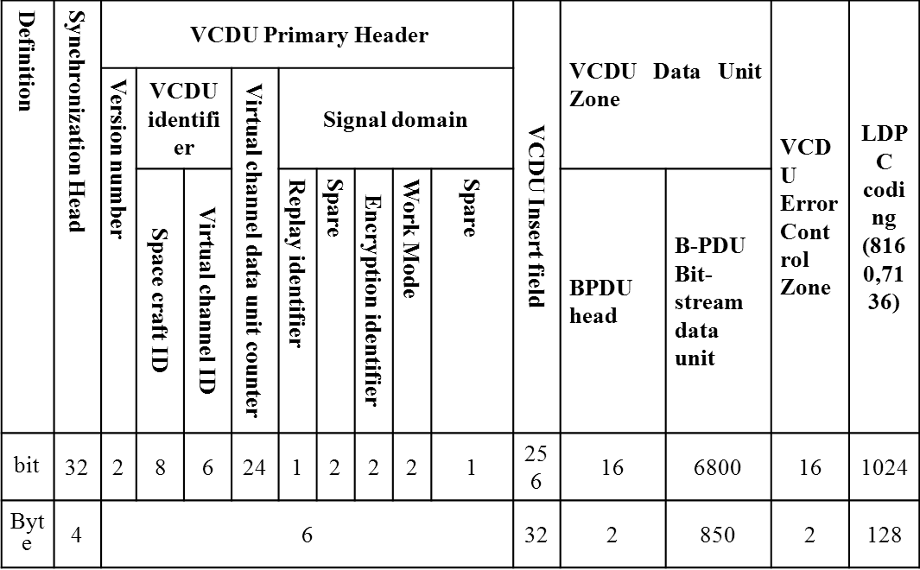
Data Handling–Frame Format
Encryption
CRC
Scrambling / LDPC
THIS DOCUMENT CONTAINS PROPRIETARY INFORMATION OF CHINA ACADEMY OF SPACE TECHNOLOGY, AND MAY NOT BE REPRODUCED, COPIED, DISCLOSED, UTILIZED, PLACED OR TRANSMITTED ON INTERNET, IN WHOLE OR IN PART, WITHOUT PRIOR WRITTEN AUTHORIZATION.
PAGE <number>

Slide 34
Data Handling–Frame Format
Item |  | Value | Comment
Synchronous head |  | 0x1ACFF1D | AOS standard of CCSDS
VCDU Primary Header | Version number | 01 | identify CCSDS virtual channel data cell
 | Spacecraft identifier | 0x1A | be used to identify the spacecraft that delivery this VCDU data
 | virtual channel identifier | 6-bits | identify each virtual channel
 | VCDU counter | 3 bytes | Provide a separate count for each virtual channel
 | Replay identifier | “0”, “1”replay
 | Encryption identifier | 00”：Viad
 | VCDU insert field | 32 bytes(reserved) | to storage the Encryption key
VCDU Data Unit Zone | BPDU head | 2 bytes
 | BPDU data unit | 850 bytes | Image data
LDPC coding zone |  | 128 bytes | all parts should be encoded by 7/8 LDPC (8160, 7136), except the synchronize head
THIS DOCUMENT CONTAINS PROPRIETARY INFORMATION OF CHINA ACADEMY OF SPACE TECHNOLOGY, AND MAY NOT BE REPRODUCED, COPIED, DISCLOSED, UTILIZED, PLACED OR TRANSMITTED ON INTERNET, IN WHOLE OR IN PART, WITHOUT PRIOR WRITTEN AUTHORIZATION.
PAGE <number>

Slide 35

OUTLINES
Introduction to DTS
Data Handling
Data Transmission
THIS DOCUMENT CONTAINS PROPRIETARY INFORMATION OF CHINA ACADEMY OF SPACE TECHNOLOGY, AND MAY NOT BE REPRODUCED, COPIED, DISCLOSED, UTILIZED, PLACED OR TRANSMITTED ON INTERNET, IN WHOLE OR IN PART, WITHOUT PRIOR WRITTEN AUTHORIZATION.
PAGE <number>

Slide 36
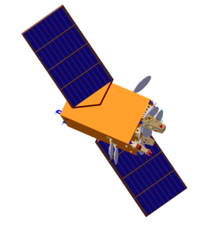
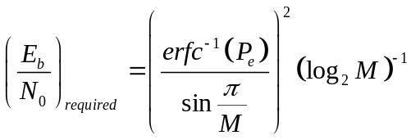
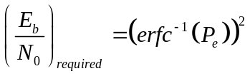

Data Transmission – Link Budget
  Successful Link Budget:
  Link Margin = (E_{b}/N₀)_{received} - (E_{b}/N₀)_{required} ≥ 3dB
  For a given P_{e},
  Since
  So
  For QPSK, M=4, so
THIS DOCUMENT CONTAINS PROPRIETARY INFORMATION OF CHINA ACADEMY OF SPACE TECHNOLOGY, AND MAY NOT BE REPRODUCED, COPIED, DISCLOSED, UTILIZED, PLACED OR TRANSMITTED ON INTERNET, IN WHOLE OR IN PART, WITHOUT PRIOR WRITTEN AUTHORIZATION.
PAGE <number>

Slide 37
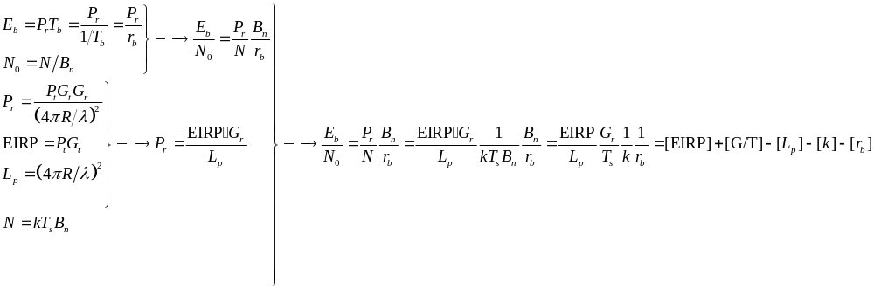
Data Transmission – Link Budget
  (E_{b}/N₀)_{received}
THIS DOCUMENT CONTAINS PROPRIETARY INFORMATION OF CHINA ACADEMY OF SPACE TECHNOLOGY, AND MAY NOT BE REPRODUCED, COPIED, DISCLOSED, UTILIZED, PLACED OR TRANSMITTED ON INTERNET, IN WHOLE OR IN PART, WITHOUT PRIOR WRITTEN AUTHORIZATION.
PAGE <number>

Slide 38
Data Transmission – Link Budget
E_{b} | Bit Energy
N₀ | Single Side Band Noise Power Spectral Density
P_{r} | Power of Received Signal
T_{b} | Time Period for 1 bit (assuming the time period for a symbol is divided by each bit it carried)
r_{b} | Bit Rate
B_{n} | Noise Bandwidth of the Receiver
N | Noise Power of the Receiver
P_{t} | Power of Transmitted Signal
G_{t} | Gain of the Transmitter’s Antenna
G_{r} | Gain of the Receiver’s Antenna
R | Free Space Transmitted Distance
λ | Wavelength of Transmitted signal
EIRP | Equivalent Isotropic Radiated Power
L_{p} | Free Space Transmission Loss
k | Boltzmann’s Constant, =1.39×10-23J/K=-228.6dBW/K/Hz
T_{s} | Time Period for 1 Transmitted Symbol
G/T | G/T Value of the Receiver System
THIS DOCUMENT CONTAINS PROPRIETARY INFORMATION OF CHINA ACADEMY OF SPACE TECHNOLOGY, AND MAY NOT BE REPRODUCED, COPIED, DISCLOSED, UTILIZED, PLACED OR TRANSMITTED ON INTERNET, IN WHOLE OR IN PART, WITHOUT PRIOR WRITTEN AUTHORIZATION.
PAGE <number>

Slide 39
Data Transmission – Link Budget
Item | Data
Free Space Transmitted Distance(Km) | 2394
Loss in space（dB） | 178.3
Frequency（GHz） | 8.16
EIRP（dBW） | 18
Loss of polar（dB） | 1
Channel rate（Mbps） | 100
G/T of the receive system (dB/K) | 28.08
Loss of pointing（dB） | 1
Atmosphere Absorption Loss（dB） | 1
Rain Loss(dB)(99.9%) | 2
Eb/No（dB） | 11.38
Gain of Channel Coding | 6
Eb/No（dB） | 11.3
Modulation Loss(dB) | 0.5
Demodulation Loss(dB) | 2
Eb/No of demand(dB) | 7.8
Link Margin (dB) | 3.58
THIS DOCUMENT CONTAINS PROPRIETARY INFORMATION OF CHINA ACADEMY OF SPACE TECHNOLOGY, AND MAY NOT BE REPRODUCED, COPIED, DISCLOSED, UTILIZED, PLACED OR TRANSMITTED ON INTERNET, IN WHOLE OR IN PART, WITHOUT PRIOR WRITTEN AUTHORIZATION.
PAGE <number>

Slide 40
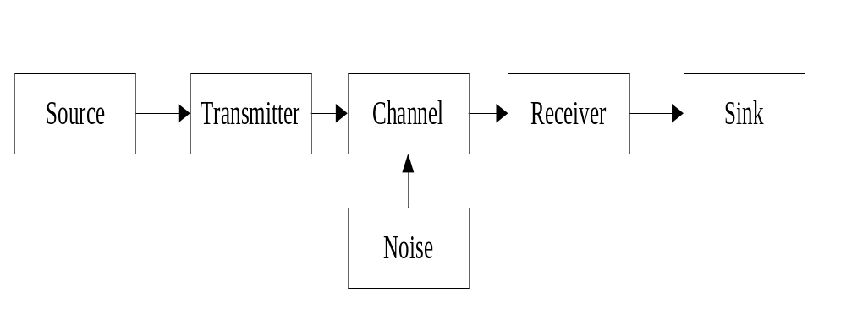
Data Transmission - Introduction
  Why data should be modulated first?
    Model of Communication System
      For reliable and effective transmission, signal transmitted should be adapted to the channel;
      Satellite-GAS downlink: wireless channel, use propagation of electromagnetic wave to transmit signal;
      Wireless channel: bandpass transmission
THIS DOCUMENT CONTAINS PROPRIETARY INFORMATION OF CHINA ACADEMY OF SPACE TECHNOLOGY, AND MAY NOT BE REPRODUCED, COPIED, DISCLOSED, UTILIZED, PLACED OR TRANSMITTED ON INTERNET, IN WHOLE OR IN PART, WITHOUT PRIOR WRITTEN AUTHORIZATION.
PAGE <number>

Slide 41
Data Transmission - Introduction
  Why data should be modulated first?
    Model of Communication System
      For reliable and effective transmission, signal transmitted should be adapted to the channel;
      Satellite-GAS downlink: wireless channel, use propagation of electromagnetic wave to transmit signal;
      Wireless channel: bandpass transmission
THIS DOCUMENT CONTAINS PROPRIETARY INFORMATION OF CHINA ACADEMY OF SPACE TECHNOLOGY, AND MAY NOT BE REPRODUCED, COPIED, DISCLOSED, UTILIZED, PLACED OR TRANSMITTED ON INTERNET, IN WHOLE OR IN PART, WITHOUT PRIOR WRITTEN AUTHORIZATION.
PAGE <number>

Slide 42
Data Transmission - Modulator
  Why data should be modulated first?
    Bandpass Transmission
      Low Frequency: Cannot penetrate the ionosphere
        <2MHz — Travel along the surface of the Earth (Ground Wave)
        2M-30MHz — bounce between the ionosphere and the surface (Ionosphere Reflection Wave)
THIS DOCUMENT CONTAINS PROPRIETARY INFORMATION OF CHINA ACADEMY OF SPACE TECHNOLOGY, AND MAY NOT BE REPRODUCED, COPIED, DISCLOSED, UTILIZED, PLACED OR TRANSMITTED ON INTERNET, IN WHOLE OR IN PART, WITHOUT PRIOR WRITTEN AUTHORIZATION.
PAGE <number>

Slide 43
Data Transmission - Modulator
  Why data should be modulated first?
    Bandpass Transmission
      Low Frequency: Hard to be transmitted
        For successful radiation, the size of antenna should be no less than 1/10 of the wavelength of signal transmitted.
        F=30MHz → λ=10Km→ D＞1Km
THIS DOCUMENT CONTAINS PROPRIETARY INFORMATION OF CHINA ACADEMY OF SPACE TECHNOLOGY, AND MAY NOT BE REPRODUCED, COPIED, DISCLOSED, UTILIZED, PLACED OR TRANSMITTED ON INTERNET, IN WHOLE OR IN PART, WITHOUT PRIOR WRITTEN AUTHORIZATION.
PAGE <number>

Slide 44
Data Transmission - Modulator
  Why data should be modulated first?
    Bandpass Transmission
      High Frequency: great loss → difficult to pass → no pass
        Free space loss: the loss in signal strength of an electromagnetic wave that would result from a line-of-sight path through free space.
        It is proportional to the square of the frequency of the radio signal.
        λ is the signal wavelength (in meters); f is the signal frequency (in hertz)
        R is the distance from the transmitter (in meters)
        c is the speed of light in a vacuum
THIS DOCUMENT CONTAINS PROPRIETARY INFORMATION OF CHINA ACADEMY OF SPACE TECHNOLOGY, AND MAY NOT BE REPRODUCED, COPIED, DISCLOSED, UTILIZED, PLACED OR TRANSMITTED ON INTERNET, IN WHOLE OR IN PART, WITHOUT PRIOR WRITTEN AUTHORIZATION.
PAGE <number>

Slide 45
Data Transmission - Modulator
  Why data should be modulated first?
    Bandpass Transmission
      High Frequency: great loss → difficult to pass → no pass
        The picture shows that between the frequencies of 2 GHz to 10 GHz the level of the sky noise diminishes, and this band is known as the "Waveguide window.”
        Also the rain attenuation is significant for frequencies higher than 10GHz.
THIS DOCUMENT CONTAINS PROPRIETARY INFORMATION OF CHINA ACADEMY OF SPACE TECHNOLOGY, AND MAY NOT BE REPRODUCED, COPIED, DISCLOSED, UTILIZED, PLACED OR TRANSMITTED ON INTERNET, IN WHOLE OR IN PART, WITHOUT PRIOR WRITTEN AUTHORIZATION.
PAGE <number>

Slide 46
Data Transmission - Modulator
  Why data should be modulated first?
    Modulation Type
      Modulation is the process of varying one or more properties of a periodic waveform, called the carrier signal, with a modulating signal that typically contains information to be transmitted;
      For low-speed data transmission applications (<600Mbps), MPSK (Multi-level Phase Shift Key) modulation is the most widely used type, which conveys data by changing (modulating) the phase of the carrier wave (usually a sinusoid). In other ways, the phase is changed to represent the data signal.
THIS DOCUMENT CONTAINS PROPRIETARY INFORMATION OF CHINA ACADEMY OF SPACE TECHNOLOGY, AND MAY NOT BE REPRODUCED, COPIED, DISCLOSED, UTILIZED, PLACED OR TRANSMITTED ON INTERNET, IN WHOLE OR IN PART, WITHOUT PRIOR WRITTEN AUTHORIZATION.
PAGE <number>

Slide 47
Data Transmission - Modulator
  Why data should be modulated first?
    Modulation Type
      A convenient method to represent MPSK schemes is on a constellation diagram. This shows the points in the complex plane where the real and imaginary axes are termed the in-phase and quadrature axes respectively due to their 90° separation. Such a representation on perpendicular axes lends itself to straightforward implementation. The amplitude of each point along the in-phase axis is used to modulate a sine(or cosine) wave. By convention, in-phase modulates cosine and quadrature modulates sine.
THIS DOCUMENT CONTAINS PROPRIETARY INFORMATION OF CHINA ACADEMY OF SPACE TECHNOLOGY, AND MAY NOT BE REPRODUCED, COPIED, DISCLOSED, UTILIZED, PLACED OR TRANSMITTED ON INTERNET, IN WHOLE OR IN PART, WITHOUT PRIOR WRITTEN AUTHORIZATION.
PAGE <number>

Slide 48
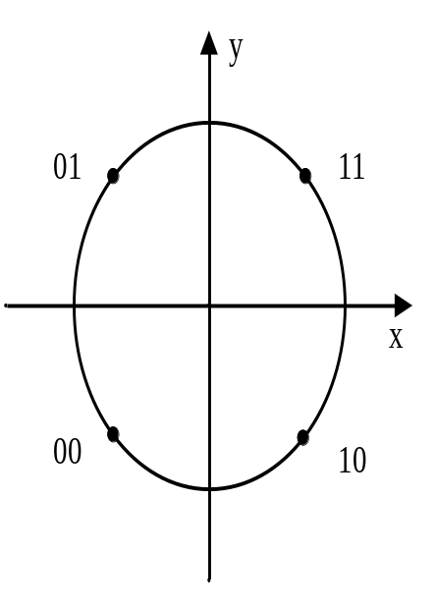
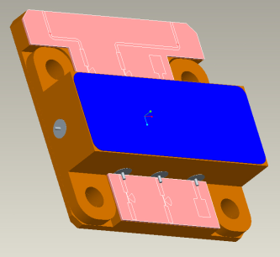
Data Transmission - Modulator
  Why data should be modulated first?
    Modulation Type
      In ETRSS-1, we use QPSK(Quadrature Phase-Shifting Keying).
      QPSK uses four points on the constellation diagram, equispaced around a circle. With four phases, QPSK can encode two bits per symbol, shown in the diagram with Grey coding to minimize the bit error rate(BER).
THIS DOCUMENT CONTAINS PROPRIETARY INFORMATION OF CHINA ACADEMY OF SPACE TECHNOLOGY, AND MAY NOT BE REPRODUCED, COPIED, DISCLOSED, UTILIZED, PLACED OR TRANSMITTED ON INTERNET, IN WHOLE OR IN PART, WITHOUT PRIOR WRITTEN AUTHORIZATION.
PAGE <number>

Slide 49
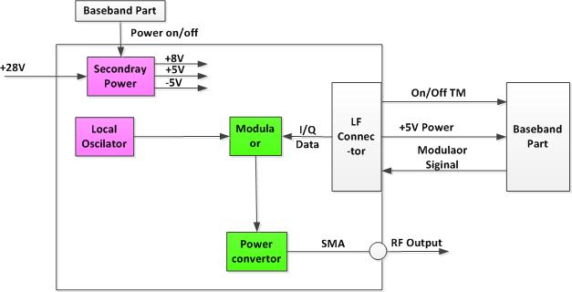
Data Transmission - Modulator
THIS DOCUMENT CONTAINS PROPRIETARY INFORMATION OF CHINA ACADEMY OF SPACE TECHNOLOGY, AND MAY NOT BE REPRODUCED, COPIED, DISCLOSED, UTILIZED, PLACED OR TRANSMITTED ON INTERNET, IN WHOLE OR IN PART, WITHOUT PRIOR WRITTEN AUTHORIZATION.
PAGE <number>

Slide 50
Data Transmission – Power Amplifier
  Power Amplifier
    An amplifier uses electric power from a power supply to increase the amplitude of a signal.
    Properties are given by parameters that include:
      Gain, the ratio between the magnitude of output and input signals;
      Bandwidth, the width of the useful frequency range;
      Efficiency, the ratio between the power of the output and total power consumption;
      Linearity, the extent to which the proportion between input and output amplitude is the same for high amplitude and low amplitude input;
THIS DOCUMENT CONTAINS PROPRIETARY INFORMATION OF CHINA ACADEMY OF SPACE TECHNOLOGY, AND MAY NOT BE REPRODUCED, COPIED, DISCLOSED, UTILIZED, PLACED OR TRANSMITTED ON INTERNET, IN WHOLE OR IN PART, WITHOUT PRIOR WRITTEN AUTHORIZATION.
PAGE <number>

Slide 51
Data Transmission –Antenna
  Antenna
      An antenna is an electrical device which converts electric power into radio waves, and vice versa. In transmission, a transmitter supplies an electric current to the antenna’s terminals, and the antenna radiates the energy from the current as electromagnetic waves.
      Antennas can be designed to transmit radio waves preferentially in a particular direction to achieve higher gain. In this case, an antenna may includes additional elements or surfaces such as parasitic elements, parabolic reflectors or horns, which serve to direct the radio waves into beam or other desired radiation pattern.
THIS DOCUMENT CONTAINS PROPRIETARY INFORMATION OF CHINA ACADEMY OF SPACE TECHNOLOGY, AND MAY NOT BE REPRODUCED, COPIED, DISCLOSED, UTILIZED, PLACED OR TRANSMITTED ON INTERNET, IN WHOLE OR IN PART, WITHOUT PRIOR WRITTEN AUTHORIZATION.
PAGE <number>

Slide 52
Data Transmission –Antenna
  Antenna
    Properties are given by parameters that include:
      Bandwidth, the width of the useful frequency range, out of which the antenna impedance becomes a poor match to the transmission line;
      Gain, the ratio of the intensity I radiated by the antenna in direction of its maximum output, at an arbitrary distance, divided by the intensity I_{iso} radiated at the same distance by a hypothetical isotropic antenna which radiates equal power in all directions;
      Radiation pattern, a plot of the relative field strength of the radio waves emitted by the antenna at different angles;
THIS DOCUMENT CONTAINS PROPRIETARY INFORMATION OF CHINA ACADEMY OF SPACE TECHNOLOGY, AND MAY NOT BE REPRODUCED, COPIED, DISCLOSED, UTILIZED, PLACED OR TRANSMITTED ON INTERNET, IN WHOLE OR IN PART, WITHOUT PRIOR WRITTEN AUTHORIZATION.
PAGE <number>

Slide 53
Data Transmission –Antenna
  Antenna
    Properties are given by parameters that include:
      Impedance. A SWR(Standing Wave Ratio) of 1.5:1 is considered to be marginally acceptable in low power applications;
      Polarization, refers to the orientation of the electric field(E-plane) of the radio wave with respect to the Earth’s surface. It is best for the receiving antenna to match the polarization of the transmitted wave for optimum reception. Intermediate matchings will lose some signal strength.
THIS DOCUMENT CONTAINS PROPRIETARY INFORMATION OF CHINA ACADEMY OF SPACE TECHNOLOGY, AND MAY NOT BE REPRODUCED, COPIED, DISCLOSED, UTILIZED, PLACED OR TRANSMITTED ON INTERNET, IN WHOLE OR IN PART, WITHOUT PRIOR WRITTEN AUTHORIZATION.
PAGE <number>

Slide 54
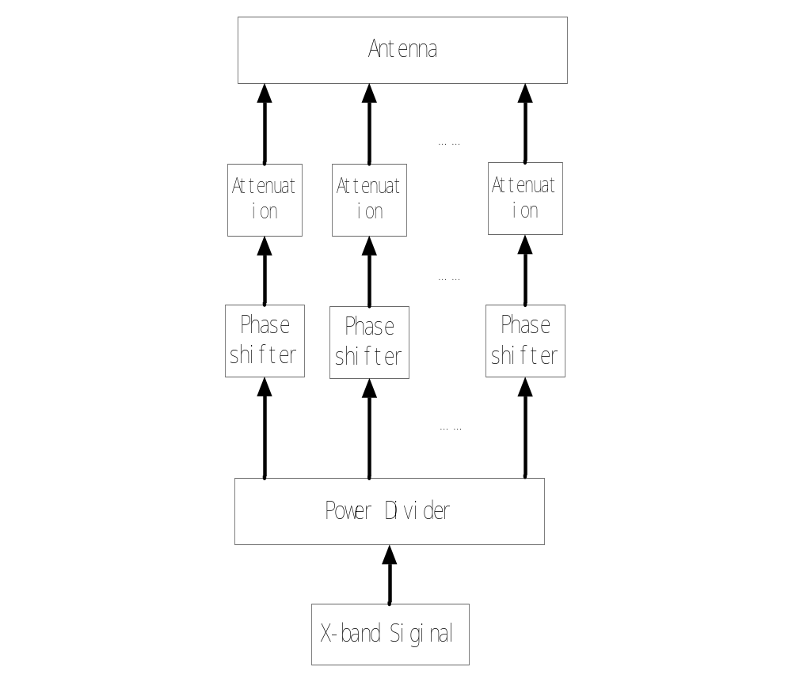
Data Transmission – Antenna
THIS DOCUMENT CONTAINS PROPRIETARY INFORMATION OF CHINA ACADEMY OF SPACE TECHNOLOGY, AND MAY NOT BE REPRODUCED, COPIED, DISCLOSED, UTILIZED, PLACED OR TRANSMITTED ON INTERNET, IN WHOLE OR IN PART, WITHOUT PRIOR WRITTEN AUTHORIZATION.
PAGE <number>

Slide 55
Data Transmission –Antenna
Item | Requirement
Antenna Bandwidth | 200 MHz
Polarization | Circular Right-hand
EIRP | ≥ 18 dBW
Tracking requirements | Cover Range: -70°~+70°
Total start-up times | 2 years ≥5840 times (8 times per day)
THIS DOCUMENT CONTAINS PROPRIETARY INFORMATION OF CHINA ACADEMY OF SPACE TECHNOLOGY, AND MAY NOT BE REPRODUCED, COPIED, DISCLOSED, UTILIZED, PLACED OR TRANSMITTED ON INTERNET, IN WHOLE OR IN PART, WITHOUT PRIOR WRITTEN AUTHORIZATION.
PAGE <number>

Slide 56
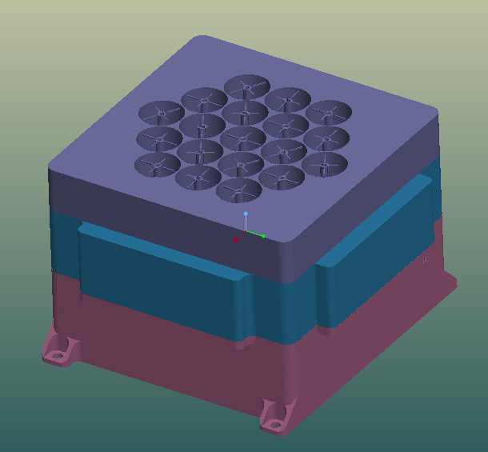
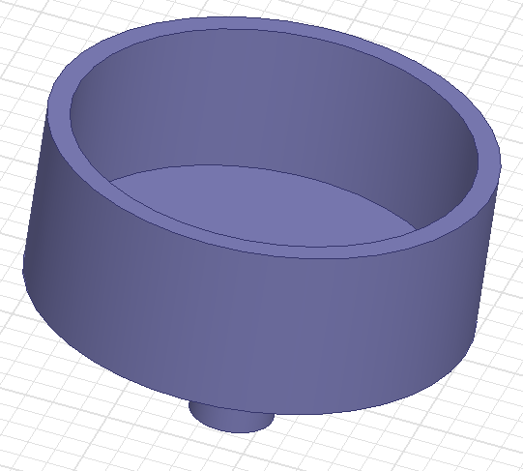
Mission Analysis – Antenna Type
  Phased-Array Antenna
    No Mechanical rotation
    Only Digital Siginal
THIS DOCUMENT CONTAINS PROPRIETARY INFORMATION OF CHINA ACADEMY OF SPACE TECHNOLOGY, AND MAY NOT BE REPRODUCED, COPIED, DISCLOSED, UTILIZED, PLACED OR TRANSMITTED ON INTERNET, IN WHOLE OR IN PART, WITHOUT PRIOR WRITTEN AUTHORIZATION.
PAGE <number>

Slide 57



